Slide 1

PROJECT PRESENTATION

Slide 2
TABLE OF CONTENTS
01
02
03
04
OUR TEAM
OUR GOAL
STAGES OF REALIZATION
USED TECHNOLOGIES

Slide 3
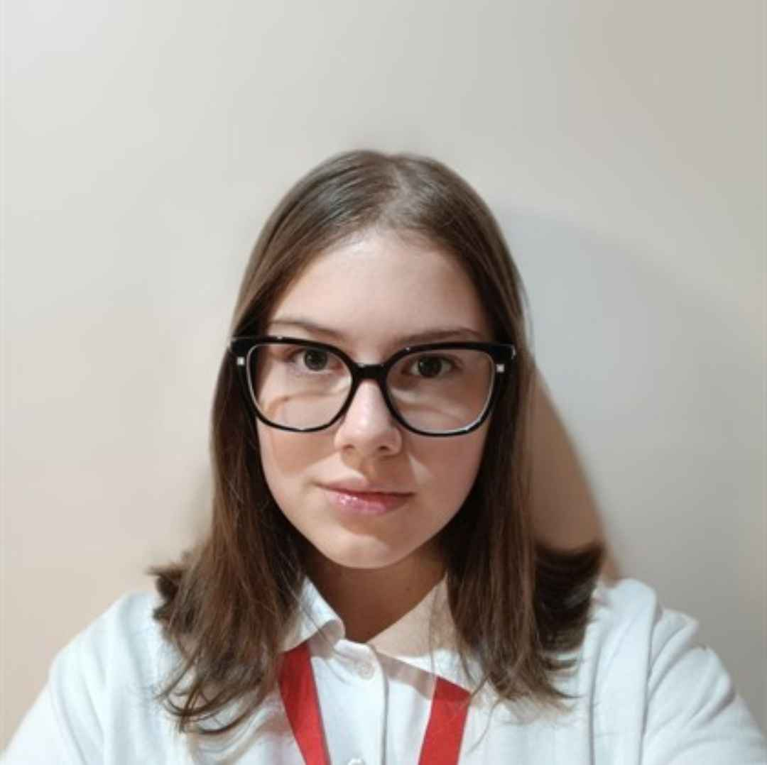
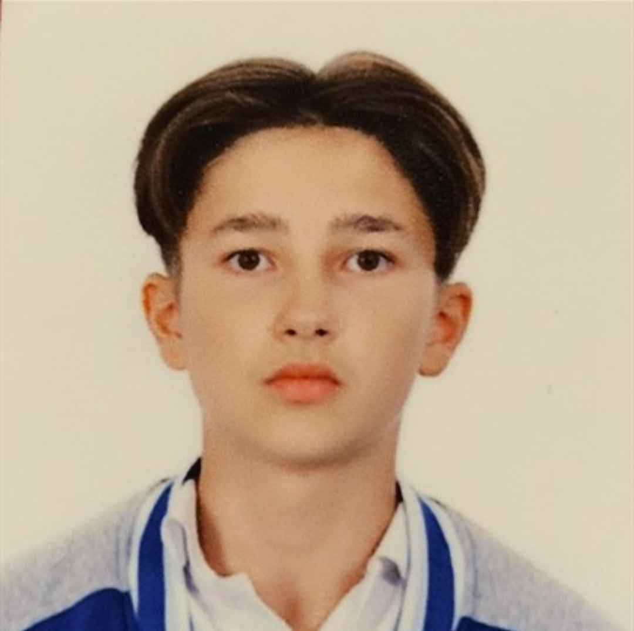
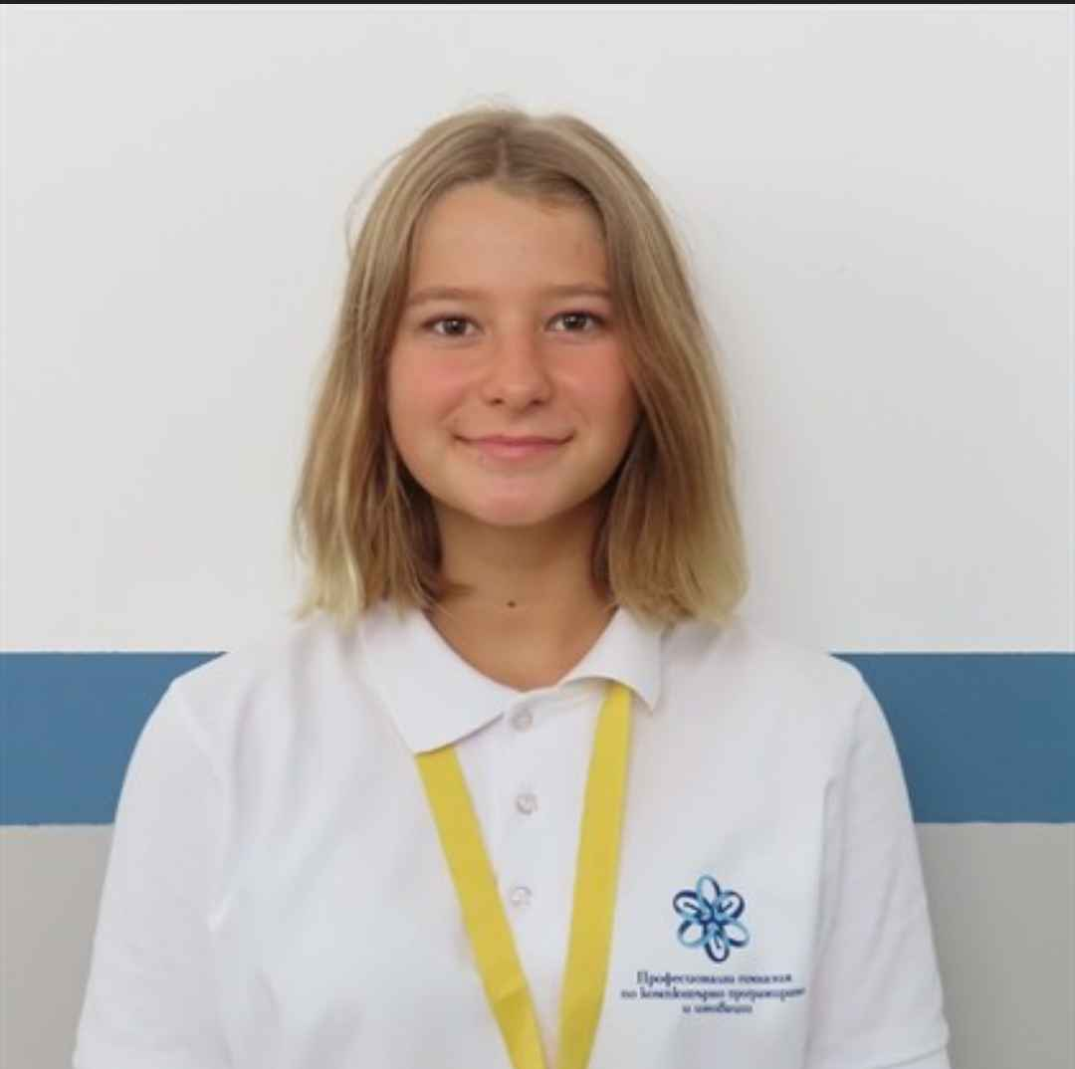
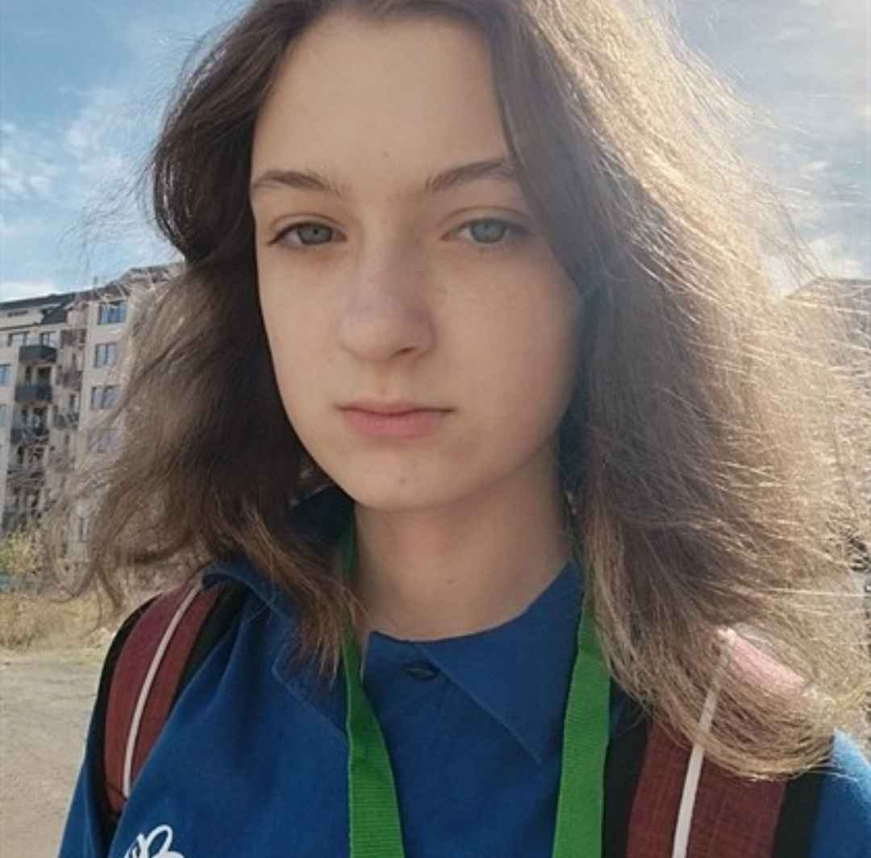
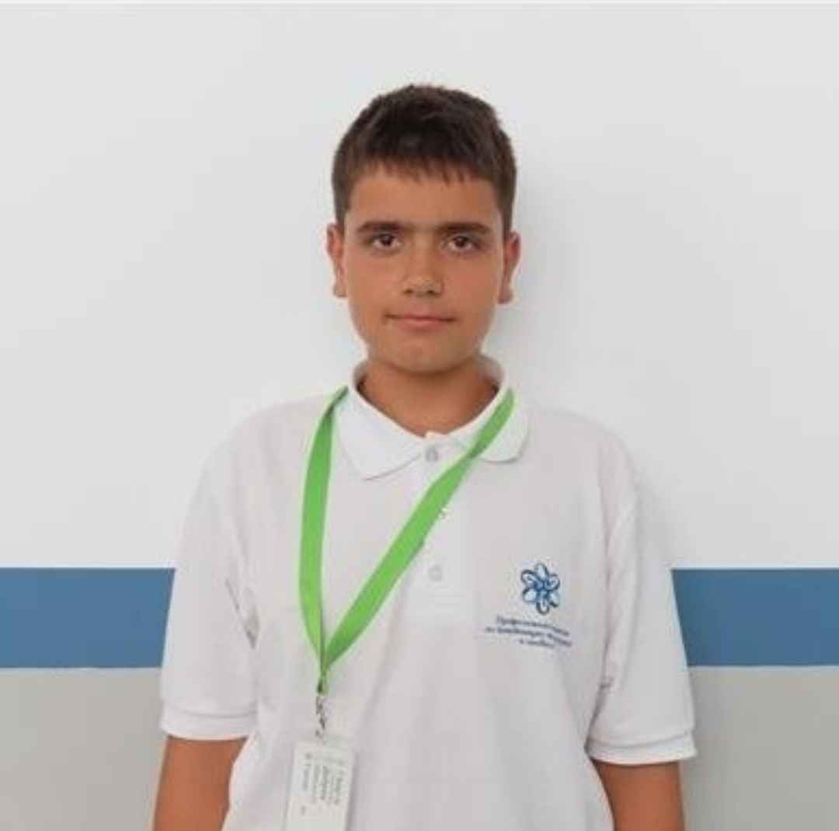
OUR TEAM
Elizaveta Furnika
Ivan Beknev
Varvara Safonova
Daria Larichkina
Georgy Dobrev
SCRUM TRAINER
Designer
Second designer
BACK-END DEVELOPER
FRONT-END DEVELOPER

Slide 4

OUR GOAL
Our goal is for the player to have fun playing our game and also to test their knowledge of mathematics
,

Slide 5
STAGES OF REALISATION
ORGANISATION
DECIDE ON THE IDEA
DEVELOPMENT
PRESENTATION

Slide 6






USED TECHNOLOGIES
,

Slide 7
LET’S CONTINUE WITH THE GAME!

Slide 8
THANK YOU FOR THE ATTENTION!

